Slide 1
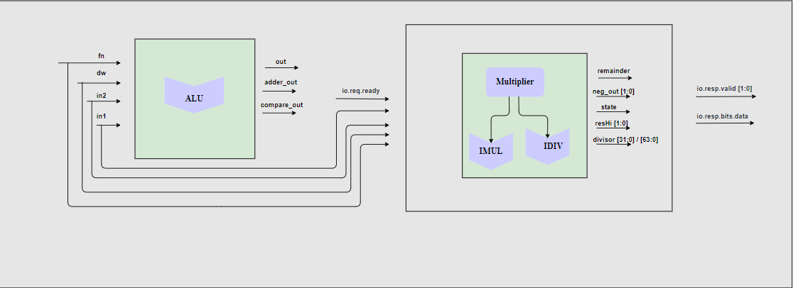
Execute Block Flow
We have 4 inputs fn (function bits),dw (data width),in1(operand A of alu),in2 (operand B of Alu) and ready bits of Multiplier
Alu block has 4 inputs fn,dw,in1,in2 and 3 outputs out, adder_out and compare_out. Out =output of bitwise operator adder_out=mathematical operation output compare_out=branch comparaision result
For Multiplier we have 5 Inputs io.req.ready (this will tell wether we have multiplier instruction) rest of 4 inputs are same as of Alu Remainder output will show the output of division operation whereas if we have negative remainder we have neg_out pin as High State output will tell in which state our multiplier is (For example multiplication/division done or not ) resHi output will be high if we have positive remainder Divisor output will show divisior data io.resp.valid output will show wether we have valid output or not io.resp.bits.data will show the output of multiplier

